Slide 1



ACCELERATE YOUR ROLE-PLAY SKILLS
How to get to the finish line with your role-play!

Slide 2


ABOUT US
Manya Pradeep Narayan
Sidhya Ganesh
AREA 3 PRESIDENT & VP OF CAREER DEV
AREA 4 PRESIDENT & VP OF CAREER DEV

Slide 3

ICEBREAKER
Ask a person around you for their:
Name
School
Favorite Dessert
Then discuss...
What do you know about role-plays already?

Slide 4


SHARE OUT:
What do you already know about role-plays?

Slide 5

WHAT IS A ROLEPLAY?
  Scenarios set in specialized career areas
  Deliver presentation based on scenario to judge
  Winners selected based on cluster exam & role-play score
Individual Series
Team Decision Making

Slide 6


TWO PARTS TO A ROLE-PLAY
PREPARATION
PRESENTATION
10 MINUTES
10 MINUTES
10 MINUTES

Slide 7

#1 - PREPARATION
  1.1 Analyzing your case study
  1.2 Copying down and understanding Performance Indicators (PIs)
  1.3 Developing an outline of your presentation
  1.4 Creating props for your presentation

Slide 8
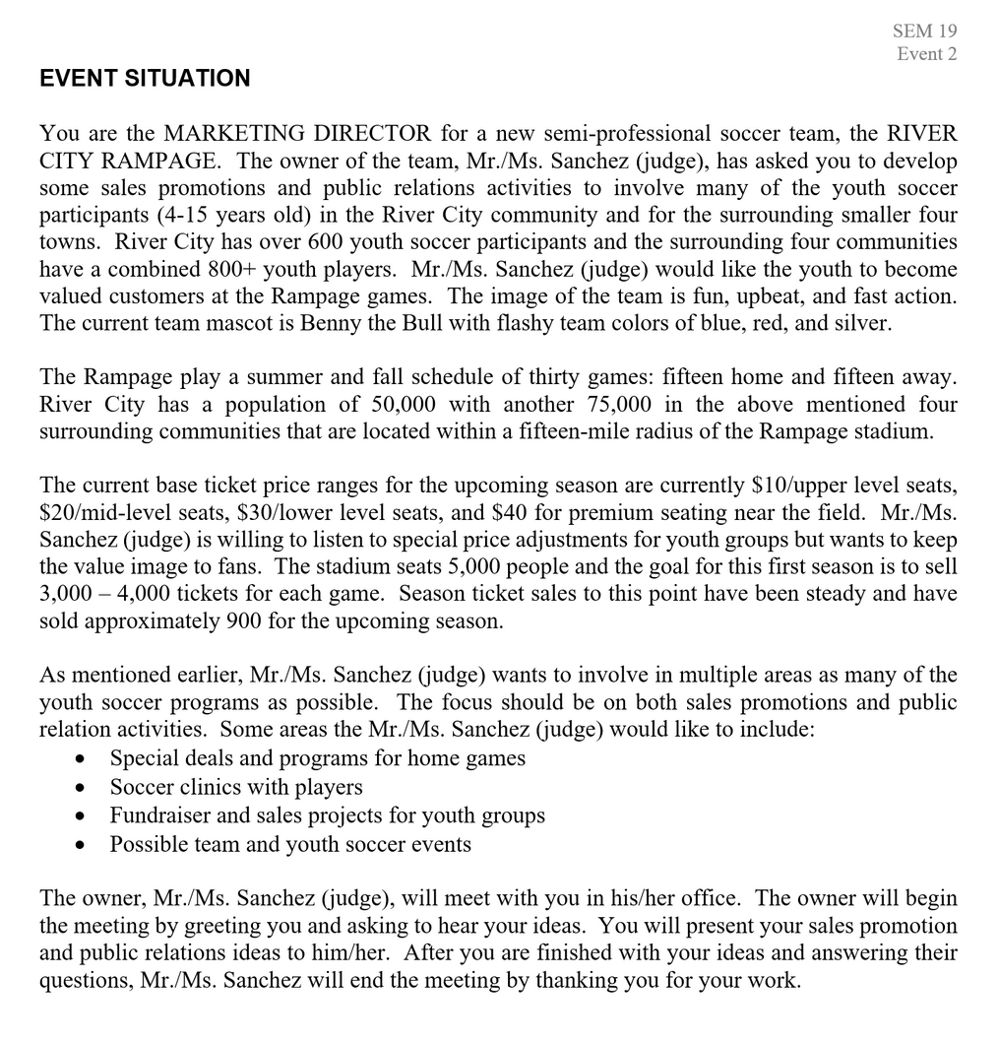

1.1) ANALYZING A CASE STUDY
TAKE A PICTURE!

Slide 9
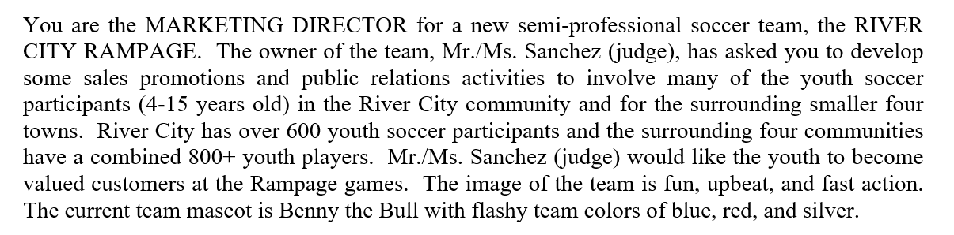
1.1) ANALYZING A CASE STUDY
Paragraph One
1. You are: A marketing director
2. Judge is: The owner of the team
3. The company is: River City Rampage, a new semi-professional soccer team

Slide 10

1.1) ANALYZING A CASE STUDY
Paragraph One
DELIVERABLE!

Slide 11
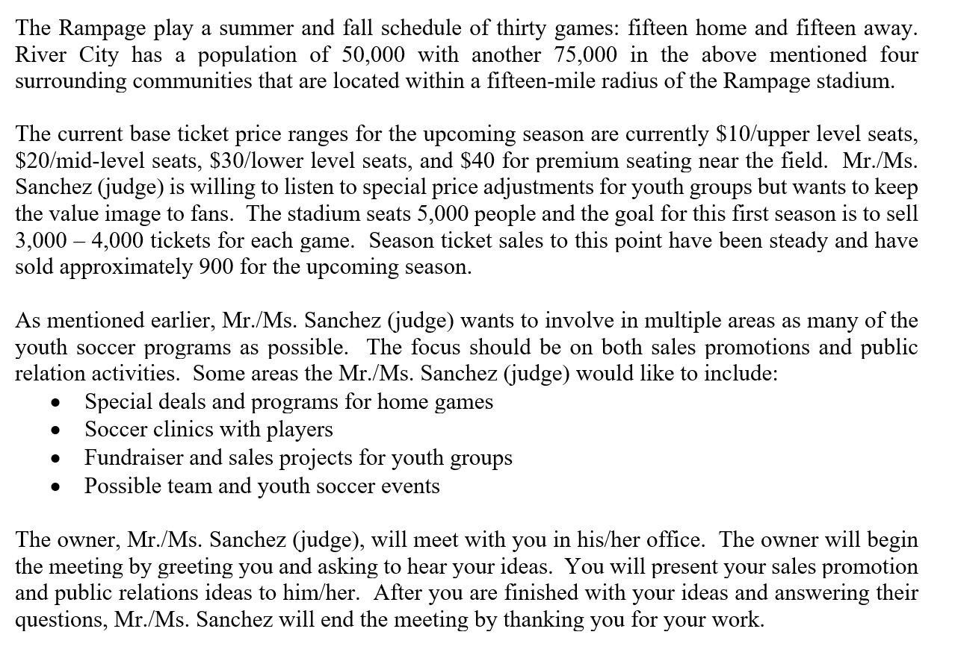
1.1) ANALYZING A CASE STUDY
Scenario Details
Scenario Details
Specific Deliverables
Standard Ending

Slide 12
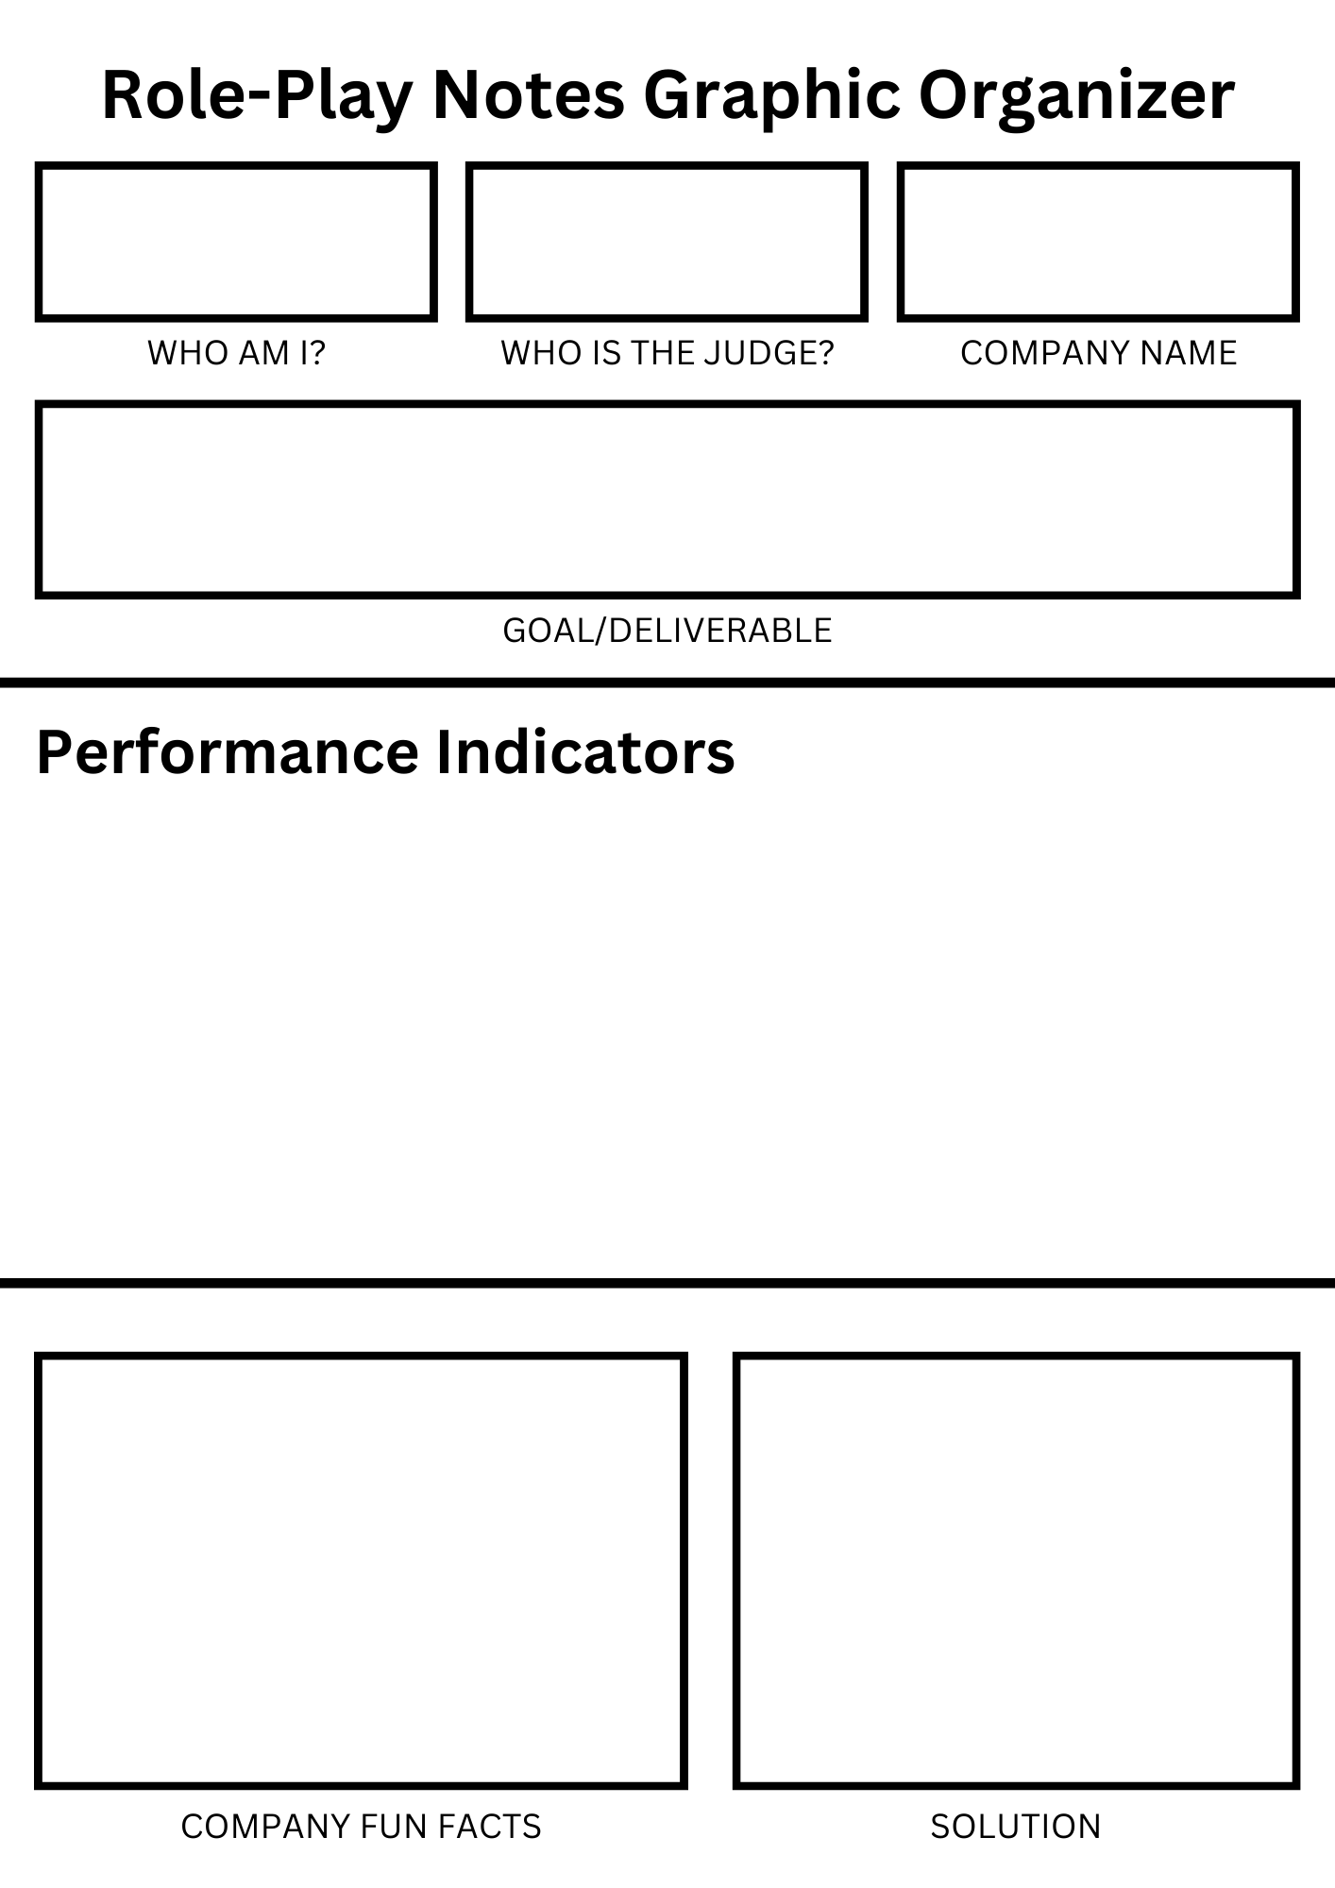
1.1) ANALYZING A CASE STUDY
Don’t Write Yet!

Slide 13
1.1) ANALYZING A CASE STUDY

Slide 14
ANALYZING A CASE STUDY
Marketing Director

Slide 15
ANALYZING A CASE STUDY
Owner of a new semi-professional soccer team
Marketing Director

Slide 16
ANALYZING A CASE STUDY
Owner of a new semi-professional soccer team
River City
Rampage
Marketing Director
Develop some sales promotions and PR activities to involve many of the youth soccer participants in the River City community involving deals for home games, soccer clinics with players, fundraisers for youth groups, possible team and youth soccer events.

Slide 17
ANALYZING A CASE STUDY
Owner of a new semi-professional soccer team
River City
Rampage
Marketing Director
Develop some sales promotions and PR activities to involve many of the youth soccer participants in the River City community involving deals for home games, soccer clinics with players, fundraisers for youth groups, possible team and youth soccer events.

Slide 18
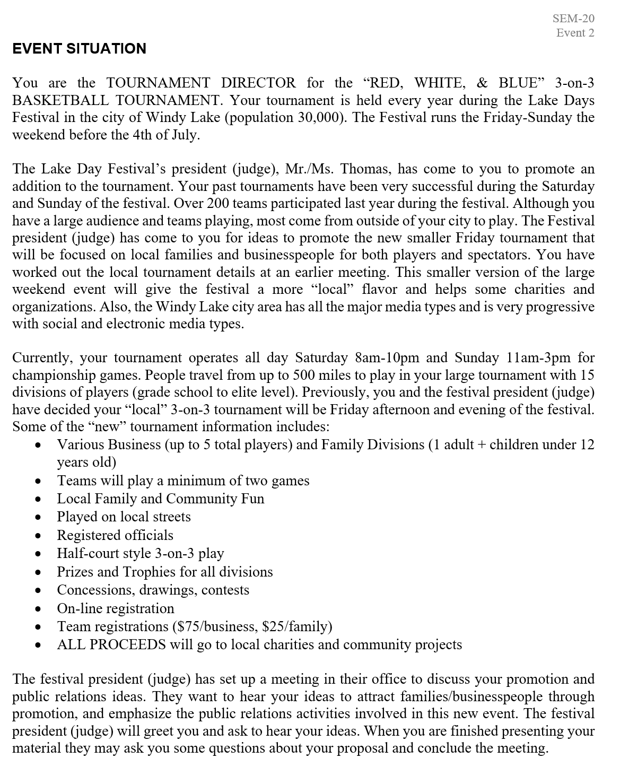
IT’S YOUR TURN!
TAKE X MINUTES
TAKE A PICTURE!

Slide 21
ANALYZING A CASE STUDY

Slide 22
ANALYZING A CASE STUDY
Tournament Director

Slide 23
ANALYZING A CASE STUDY
Tournament Director
Lake Day Festival’s president

Slide 24
ANALYZING A CASE STUDY
“Red, White & Blue”
3-on-3 Basketball Tournament
Tournament Director
Lake Day Festival’s president

Slide 25
ANALYZING A CASE STUDY
“Red, White & Blue”
3-on-3 Basketball Tournament
Tournament Director
Lake Day Festival’s president
Promote the smaller Friday tournament that is focused on local families and businesses for players and spectators. Focus on public relations activities.

Slide 26

WHAT ARE PERFORMANCE INDICATORS (PIs)?
Performance Indicators are based on content relevant to your event topic
You must integrate the performance indicators into your roleplay presentation
PERFORMANCE INDICATORS IN INDIVIDUAL SERIES ROLE-PLAYS

Slide 27
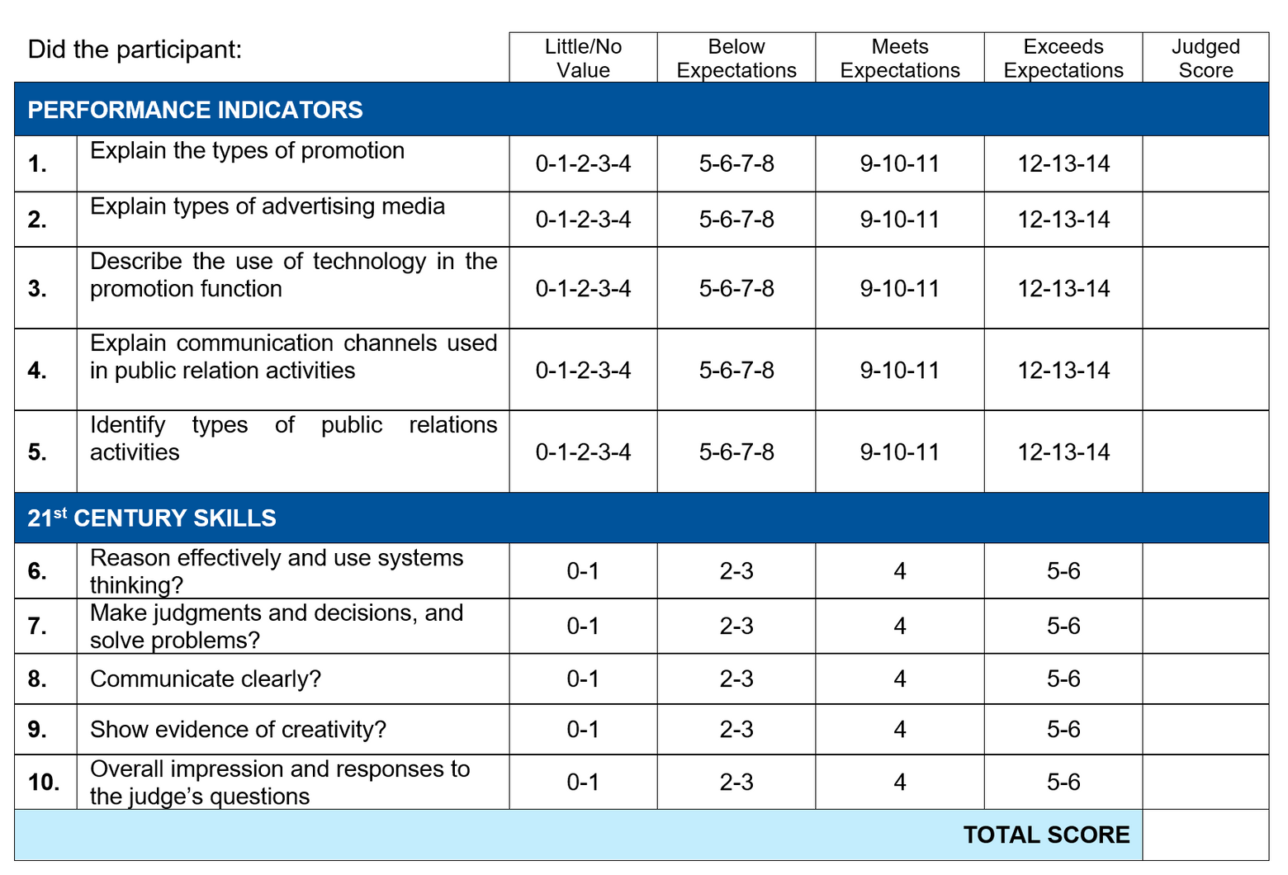
WHAT ARE PERFORMANCE INDICATORS (PIs)?
You are evaluated mainly on your answers to the PIs!
Write your PIs down! You can’t take the case study with you when presenting!

Slide 28
HOW TO ANSWER A PERFORMANCE INDICATOR
D
Describe your PI - say it word for word!
E
C
A

Slide 29
HOW TO ANSWER A PERFORMANCE INDICATOR
D
Describe your PI - say it word for word!
E
Explain your PI’s topic to demonstrate understanding.
C
A

Slide 30
HOW TO ANSWER A PERFORMANCE INDICATOR
D
Describe your PI - say it word for word!
E
Explain your PI’s topic to demonstrate understanding.
C
Connect your PI to your role-play scenario.
A

Slide 31
HOW TO ANSWER A PERFORMANCE INDICATOR
D
Describe your PI - say it word for word!
E
Explain your PI’s topic to demonstrate understanding.
C
Connect your PI to your role-play scenario.
A
Above and beyond - use creative props, real world scenarios, etc to take your answer to the next level.

Slide 32

EXAMPLE PI RESPONSE!
D
Describe your PI - say it word for word!
There are several types of promotion, which can be utilized to spread word about our tournament.
E
Explain your PI’s topic to demonstrate understanding.
There are 5 elements of the promotional mix: advertising, selling, direct marketing, sales promotion, public relations
C
Connect your PI to your role-play scenario.
While our team registration deals are examples of sales promotions, the fact that our proceeds go to local charities is great for our PR
A
Above and beyond - use creative props, real world scenarios, etc to take your answer to the next level.
A visual with examples of each of these elements and how they tie in with our promotional plan.

Slide 33
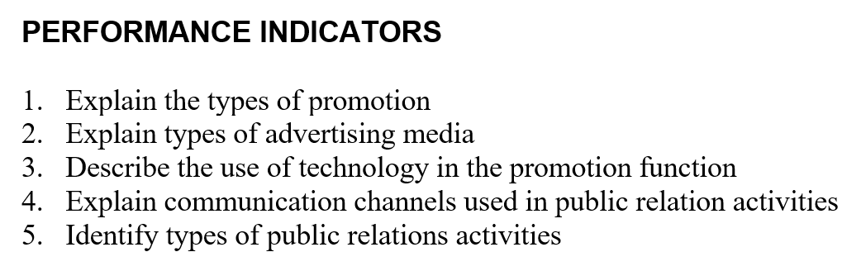
It’s Your Turn!
Pick ONE PI (#2-#5) to write in the DECA PI section of your graphic organizer.

Slide 34
EXAMPLE PI RESPONSE!
D
Describe your PI - say it word for word!
There are several types of promotion, which can be utilized to spread word about our tournament.
Take 4 mins!
E
Explain your PI’s topic to demonstrate understanding.
There are 5 elements of the promotional mix: advertising, selling, direct marketing, sales promotion, public relations
C
Connect your PI to your role-play scenario.
While our team registration deals are examples of sales promotions, the fact that our proceeds go to local charities is great for our PR
A
Above and beyond - use creative props, real world scenarios, etc to take your answer to the next level.
A visual with examples of each of these elements and how they tie in with our promotional plan.

Slide 35

Share your PI answer with someone around you!
We’ll circle back in 5 minutes!

Slide 36
SHOW A SLIDE ON HERE ABOUT WHY 21ST CENTURY SKILLS MATTER
PUT THE RUBRIC

Slide 37




WHAT ARE 21ST CENTURY SKILLS?
CRITICAL THINKING
COMMUNICATION
REASON EFFECTIVELY AND USE SYSTEMS THINKING
COMMUNICATE CLEARLY WITH CONFIDENCE
PROBLEM SOLVING
CREATIVITY
MAKE JUDGMENTS AND DECISIONS AND SOLVE PROBLEMS
SHOW EVIDENCE OF CREATIVTY AND INNOVATION

Slide 38


POWERFUL PREP-TIME TIPS DURING COMPETITION...
  Read the PIs and think about what each one means
  Read the case study actively; make notes on your scratch paper where PIs could fit in
  Take time to gather your ideas and form your solution
  Create a presentation outline: define the PIs AND connect them with your solution/case study

Slide 39
HOW DOES EVERYTHING CONNECT?

Slide 40




SUCCESSFUL ROLE-PLAY ROADMAP...
How to begin your Roleplay:
FIRM HANDSHAKE, EYE CONTACT, SMILE, THANK THE JUDGE FOR THEIR TIME
INTRODUCE YOURSELF
- NAME
- POSITION
- PURPOSE OF PRESENTATION
SIT UP STRAIGHT, KEEP YOUR HANDS ON THE DESK
(NOT YOUR LAP)

Slide 41



SUCCESSFUL ROLEPLAY ROADMAP...
How to transition into your main presentation:
WHAT WILL YOU BE TALKING ABOUT? SHOW AN AGENDA OF TALKING POINTS.
LIST OUT ALL PIS AND THEIR CONNECTION TO THE CASE STUDY
BRIEFLY SUMMARIZE YOUR SOLUTION

Slide 42


SUCCESSFUL ROLEPLAY ROADMAP (CONT.)
How to achieve the Performance Indicators (PI):
GO IN THE ORDER THAT IS PRESENTED TO YOU ON THE CASE STUDY
WHY DOES THE PI MATTER TO THE JUDGE AND THIS CASE STUDY?
WHEN YOU PRESENT YOUR SOLUTION - BACK IT UP USING PIS

Slide 43



SUCCESSFUL ROLEPLAY ROADMAP (CONT.)
Describing your Solution:
CLEARLY EXPLAIN YOUR PROPOSED SOLUTION
ANALYZE STAKEHOLDERS AND MULTIDIMENSIONAL CHALLENGES
HIGHLIGHT 21ST CENTURY SKILLS SUCH AS CREATIVITY

Slide 44





SUCCESSFUL ROLEPLAY ROADMAP (CONT.)
How to Conclude your Roleplay:
SUMMARIZE THE PIS AND YOUR SOLUTION
THANK THE JUDGE FOR THEIR TIME & POLITELY ASK FOR QUESTIONS
PUSH IN YOUR CHAIR
MAKE A STRONG FINISH (FOR E.G. “I HOPE THIS SOLUTION ELEVATES OUR COMPANY!”
ANSWER QUESTIONS PROMPTLY AND CONFIDENTLY

Slide 45




ROLEPLAY RECAP
How to Conclude your Roleplay:
10 MIN PREP TIME
10 MIN PRESENTATION
PERFORMANCE INDICATORS & 21ST CENTURY SKILLS
ANSWER QUESTIONS WITH CLARITY AND CONFIDENCE
HIGHLIGHT KEY INFORMATION
ADDRESS THE CHALLENGES IN THE SCENARIO

Slide 46


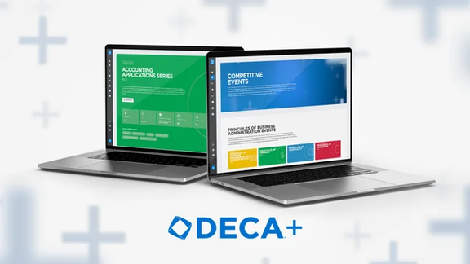

HOW TO PREPARE FOR
AREA CONFERENCE
Learn how to use props, advanced presentation techniques, and more on LearnDECA!
Watch sample role-play videos and get sample role-plays on DECA+
Build an understanding of your event subject through articles, podcasts, Quizlet, etc.
--> Search articles and subscribe to newsletters pertaining to the topic of your event!

Slide 47

Thank
you!
QUESTIONS?

