Slide 2
Get Started with DECA

Slide 3
Program agenda
Print out your Program Checklist
How do I activate my chapter?
How do I get my students excited about DECA?
How do I run a meeting?
How do I gain commitment and register my members?
How do I get my students involved and engaged to lead DECA?
How do I get decide what activities to do in DECA?

Slide 4
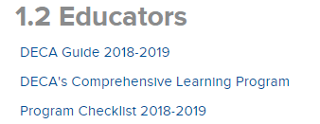
Program checklist
Program Checklist
Who to meet and know
Important forms and documents
Things to keep in mind for a successful year!

Slide 5
1. Activate your chapter
Tutorial (tutorial here)
This is done once and will result in your permanent Chapter ID#/Username being issued.

Slide 6
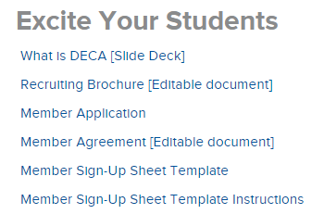
2. Excite Your Students
What is DECA Presentation
Request a State Officer visit
Chapter Campaigns can kick-off events for your members to network, engage, and grow as leaders!
Social Media Correspondent – DECA Direct – Twitter

Slide 7
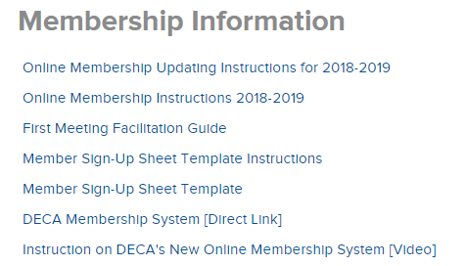
3. Meet Your Potential Members
First Meeting Facilitation Guide
Membership Application
Membership Sign-Up Sheet Instructions
Membership Sign-Up Sheet

Slide 8
4. Gain commitment
Sign-Up Sheet
Member Agreement (Chapter Management)
Collect membership dues - $8 for DECA Inc / State dues vary
Through your bookstore (bookstore managers deal with all of the money)
In class (you deal with all of the money)
Develop a tracking system for finances

Slide 9
4. register Your members
Register members through the membership portal
Membership Instructions

Slide 10
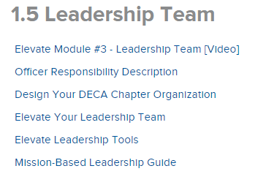
5. Lead and Elect Officer Team
Elect student leaders – look at page 23 specifically
Train student leaders – look at 15-17 specifically
Advocate for your program
Chapter Campaigns
CTE month
Community service/volunteerism

Slide 11
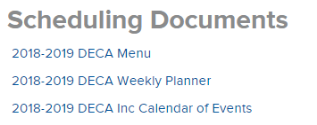
6. Schedule Your Year!
Calendars
DECA Menu
DECA Weekly Planner

